Slide 1

EMPLOYEE ATTRITION
- NIKKI ALLEN
- GOUTHAM SELVAKUMAR

Slide 2
abstract
Employee attrition refers to the gradual reduction in employees over time.
Occurs when employees retire, resign, or are replaced.
The result of a high attrition rate is that employees are leaving a company faster than they are hired.
The factors in the dataset include:
Demographic information, such as age and marital status
Wage information, such as daily rate, monthly income, and percentage of salary increase
Satisfaction metrics, such as job and environmental satisfaction, education information
Performance metrics
Career metrics such as number of companies worked, total working years, and years in current role

Slide 3
Goal of Analysis
With this bevy of information, we are working towards identifying factors from all sectors of an individual’s life, from education to salary to satisfaction, that are most important in determining attrition for a company.
This is important to measure not only to maintain a stable working environment, but also overall company growth.

Slide 4
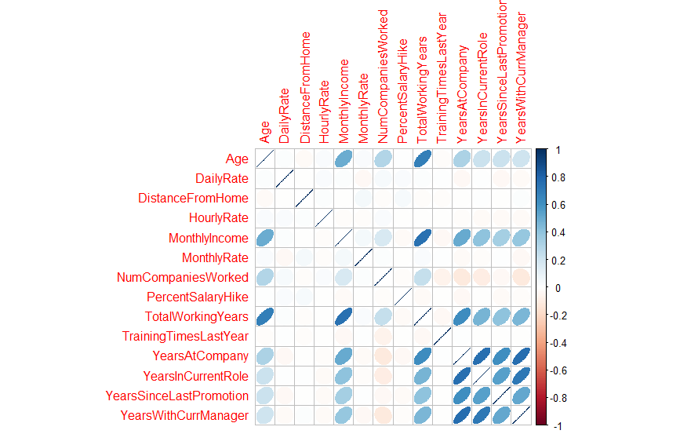
Exploratory Analysis of the Data
The original dataset on employee attrition contained a total of 1470 observations and 35 distinct variables. This dataset was determined to have no incomplete observations (i.e., no missing values)
As we are concerned with the reasoning behind employees leaving a company, we created dummy variables for our categorical variables such that we are able to use them in later predictive model building algorithms.
From the plot, it is clear that many of our variables are correlated with one another . The bottom right corner of the dataset shows significantly high levels of correlation. YearsAtCompany, YearsInCurrentRole, YearsSinceLastPromotion, and YearsWithCurrManager are all highly correlated. To address this, we will need to consider either eliminating, or combining the variables when building predictive models.

Slide 5
ANALYSIS TECHNIQUES
Because we want to determine the major factors influencing employee attrition rates, we have elected to run a scaled Principal Component Analysis (PCA) as a means of dimensionality reduction as well as feature extraction, followed by a Linear Discriminant Analysis (LDA) to find the separation between observations with individuals who have left the company versus those who have not.
Scaled Principal Component Analysis (PCA) – Dimensionality reduction, feature extraction
Linear Discriminant Analysis (LDA) – Predicting attrition based on combinations of variables and components

Slide 6
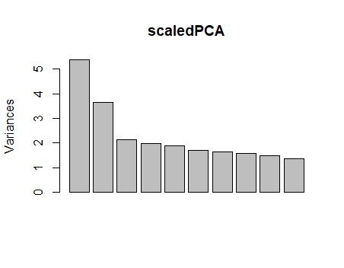
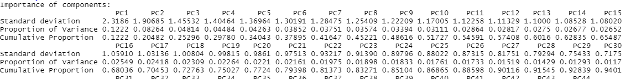
Scaled Principal Component Analysis
Principal Component Analysis – Dimensionality Reduction
Principal Component Analysis simplifies the complexity in high-dimensional data while retaining trends and patterns by creating new variables that are linear combinations of the original variables in the dataset.
Retaining as much variance as possible while reducing the number of dimensions
Results of Dimensionality Reduction PCA
Because our goal is to retain as much variance as possible while increasing parsimony, we elected to keep 18 of the 44 components, all of which have an average variance greater than 1
Retains 72.763% of the variance in the original dataset

Slide 7
Overall, through our use of scaled PCA, we were able to:
Reduce our dataset from 44 dimensions to 18 while losing less than 30% of the information in the original dataset.
We will use the results of this exploratory analysis later to generate a predictive model.
Results of scaled PCA for
Dimensionality Reduction

Slide 8
Scaled Principal Component Analysis cont.
Principal Component Analysis – Feature Extraction
Feature extraction focuses on interpretation, thus we are willing to sacrifice variance for interpretability of the model
Allows us to build components that tell us the types of employees that work in the company
Results of Feature Extraction PCA
For feature extraction we chose to use the knee test to identify the number of factors to extract (3)
Retains only 25.596% of the variance in the original dataset
Only a quarter of the variance attained through dimensionality reduction, however reduced the dimensions from 18 to 3 (83% reduction)

Slide 9
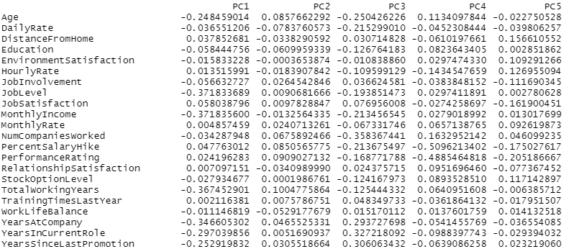
PC1 –
Most Significant Component Loadings
MonthlyIncome, JobLevel, and TotalWorkingYears
All of which have negative loadings
Interpretation
Within the company, there are not many experienced workers who are relatively high both in the organizational hierarchy and on the pay scale.
Most likely consists of high-level managers and C-Suite members
PC2 –
Most Significant Component Loadings
TotalWorkingYears, PerformanceRating, and DailyRate.
All of which have positive loadings
Interpretation
The company is comprised of quite a few experienced and productive workers
Company wants workers to be productive and increasing profit margins
PC3 –
Most Significant Component Loadings
NumCompaniesWorked, YearsInCurrentRole, and YearsSinceLastPromotion
NumCompaniesWorked has a negative loading, YearsInCurrentRole and YearsSinceLastPromotion have positive loadings
Interpretation
A significant portion of employees have worked for relatively few organization, but have worked in the same role and at the same level of pay for an extended period of time
Results of scaled PCA for
Feature Extraction – Types of Employees

Slide 10

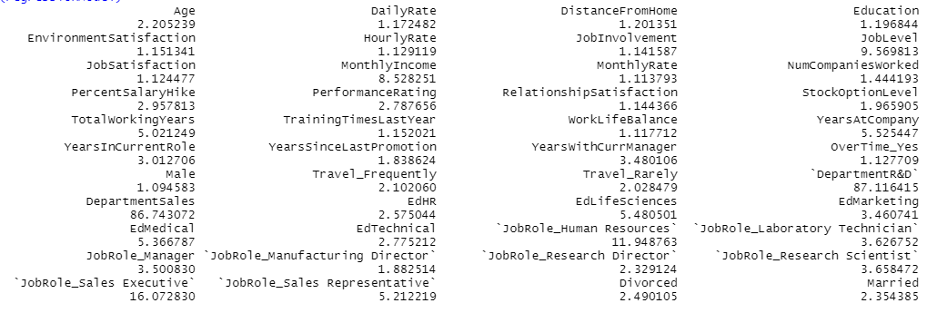
Linear Discriminant Analysis – Addressing Assumptions
Following our Principal Component Analysis, we are generating a Linear Discriminant Analysis model which we can use to predict whether or not an individual will leave a company based on specific values for the continuous and dummy variables in our dataset.
Since our exploratory analysis yielded high correlations, we first ran a regression model to check the Variance Inflation Factors
A VIF > 10 indicated significant multicollinearity
The four variables with VIF’s greater than 10 were Department_Sales, Department_Research & Development, JobRole_Sales Executive, and JobRole_Human Resources
All of which are dummy variables with > 3 levels, thus multicollinearity is expected and does not need to be addressed further

Slide 11
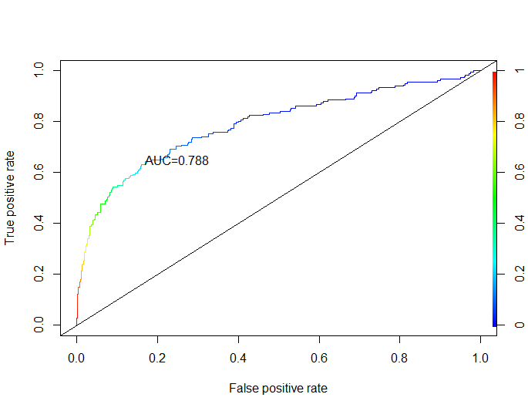
Linear Discriminant Analysis – Full Model
The first LDA model we built was on the entire dataset to yield the most important variables of the original data leading to attrition
After building the model and predicting on the testing set, the confusion matrix yielded a correct classification of 86% and the ROC plot yielded an AUC of 78.8%
AUC suggests that the model has a 78.8% chance of correctly distinguishing between positive and negative classes
Type I vs. Type II Error
We would rather misclassify an individual as leaving the company who does not (type II error) rather than misclassifying someone as staying who leaves (type I error).
Why?
While it is undoubtably important that managers continue to please individuals who will remain in the company, to lower attrition rates they will want to prioritize increasing the probability that their employees remain in the company who are considering leaving

Slide 12
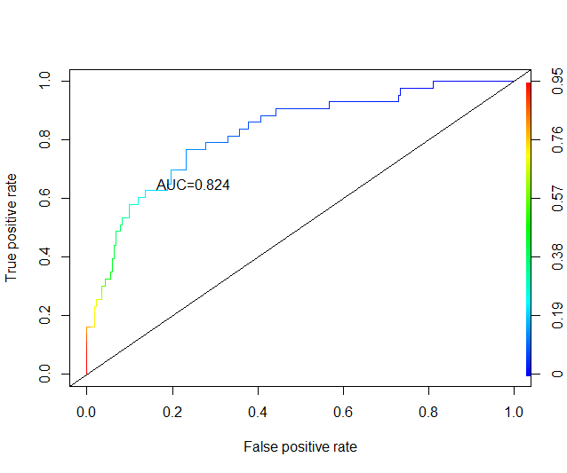
Linear Discriminant Analysis – Scaled PCA
The next LDA model we built was on the 18 principal components we extracted from PCA to determine if our dimensionality reduction techniques yielded higher accuracy
After building the model and predicting on the testing set, the confusion matrix yielded a correct classification of 85% and the ROC plot yielded an AUC of 82.4%
AUC suggests that the model has a 82.4% chance of correctly distinguishing between employee attrition and non-attrition
Interpretation of Significant Components
Component with Largest Positive Loading - PC18 (0.411225789)
Component with Largest Negative Loading - PC14 (- 0.433281260)
PC18
Characterized by JobInolvement, RelationshipSatisfaction, and TrainingTimesLastYear
All of which have negative loadings
Suggests that employees who are heavily involved with their jobs, participated in job training, and are satisfied in their personal relationships have low probabilities of leaving a company
PC14
Influenced primarily by MonthlyRate
Has a positive loading
Suggests that the higher monthly rate a person has, the less likely they are to leave a company

Slide 13
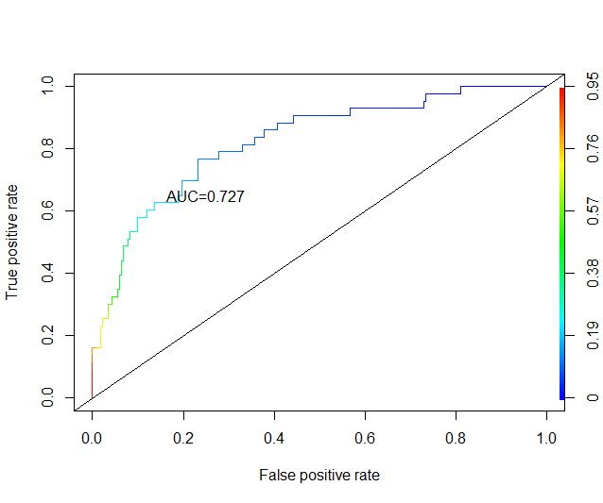
Linear Discriminant Analysis – Scaled PCA cont.
Because we have previously interpreted the first three components from PCA using feature extraction, we have built a model that can be used to determine the types of employees that are more or less likely to leave.
After building the model and predicting on the testing set, the confusion matrix yielded a correct classification of 84.42% and the ROC plot yielded an AUC of 72.7%
AUC suggests that the model has a 72.7% chance of correctly distinguishing between employee attrition and non-attrition
Lower rates makes sense as these employees constitute around a quarter of the employees in the company
Model Equation: Attrition = 0.3680094PC1 - 0.3395980PC2 - 0.1041073PC3
Interpretation
PC1- Suggests that higher level well-compensated employees (possibly CEOs or CFOs) are less likely to leave a company.
PC2 - Suggests that experienced and productive employees are more likely to leave an organization. Potentially because they do not feel their efforts are being compensated or they choose to retire.
PC3 – Suggests that employees with little experience elsewhere who have worked in the same role and at the same level for many years are more likely to leave a company. This may be because they feel that they have plateaued in the company, and still desire to grow their careers

Slide 14
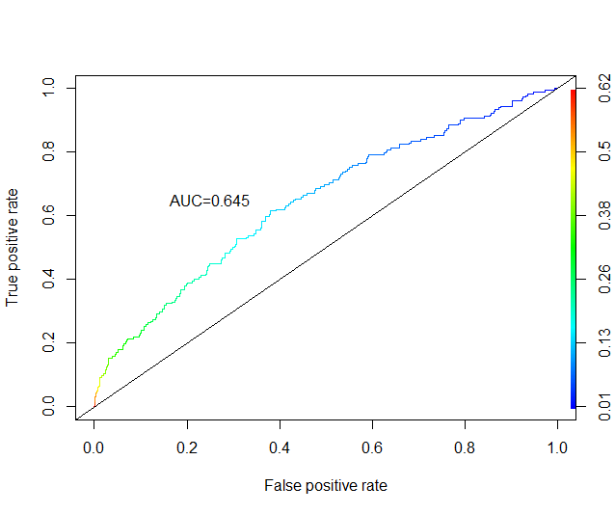
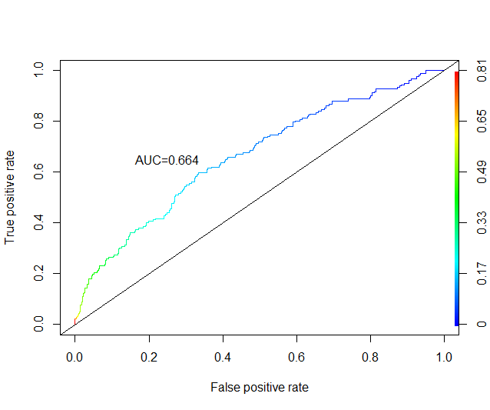
Linear Discriminant Analysis – Income and Satisfaction Metrics
Income Metrics:
Individuals attaining higher level roles must be adequately recognized and compensated for their contributions to the company.
If they are not, they have higher incentive to find an employer who recognizes their skills, and therefore, they have a higher probability of leaving the company.
Attrition = -.000104DailyRate + .377242JobLevel -1.7439MonthlyIncome -.0000276MonthlyRate -.062965PercentSalaryHike +.28380PerformanceRating + .10896NumCompaniesWorked -.03034YearsInCurrentRole - .07399YearsWithCurrManager
Satisfaction Metrics:
All variables except performance rating have negative loadings, supporting the hypothesis that higher levels of satisfaction, pertaining to not only the job itself, but also to the work environment, and outside relationships, effectively decrease the probability of attrition.
Attrition = -0.4218JobSatisfaction – 1.2748Monthly Income -0.0494RelationshipSatisfaction – 0.3468EnvironmentSatisfaction - .0426PercentSalaryHike + 0.2265PerformanceRating – 0.3979WorkLifeBalance
From the results of these models, we can see that while they both explain a similar amount of the variation in attrition rates, the linear combinations of these variables provides the best model for predicting attrition for employees.

Slide 15
LDA Conclusions
The most powerfully predictive model was the one generated on the scaled PCA dataset constituting 18 components and retaining 72% of the variation in attrition rates.
Income and satisfaction metrics are more useful predicting attrition in combination with one another rather than on their own.
Attrition can be predicted significantly well by differentiating between types of employees. Higher level executives are more likely to stay in a company than less experienced employees who have remained at the same level for a significant amount of time.

Slide 16
Practical Significance
Our models may potentially be used by corporations to help them define the areas that most influence their attrition rates. This will then grant them the ability to cater to the needs of particular types of employees, through the LDA model built on the extracted features from our Principal Component Analysis.
Our models also enable them to use the most influential factors in attrition rates to determine the areas in need of improvement in their own organization using the full LDA model, and those built from the variables influencing income and employee satisfaction.

Slide 17
Limitations
The two final models we built are not as powerfully predictive on their own, but rather in combination.
Thus, the data analytics department of any organization may use our models as a base to build their own employee attrition models with the factors that are most relevant in their own organization.
The diversity of employees varies between any organizations, thus our models are only powerful as a foundation that can be modified to fit differing organizations.

Slide 18
Thank you for Listening!

